Slide 1
Wine Quality Analysis
Mohammed Rahman, Amanda Mari, Rhea Ramsaywack,

Slide 2
Why do we care about predicting wine quality?
Average amount of wine consumed by an American in 2016: 2.94 gallons
What affects wine sales?
Price, visual appeal of the bottle… and of course, taste!
If scientists can predict what makes a wine taste “good,” wine sales can increase.
How can scientists predict a human quality rating, which is a subjective matter?
By looking at factors within the wine that they can control: chemical properties

Slide 3
The Wine Quality Dataset
4,898 observations: we are training on 4,547 and testing on 351.
Our training set has 12 chemical properties that act as predictors:
> Wine Type (binary): 3,451 red, 1,096 white
> 11 other properties: fixed acidity, volatile acidity, citric acid, residual sugar, chlorides, free sulfur dioxide, total sulfur dioxide, density, pH, sulphates, and alcohol (continuous)
Response Variable: Quality (ranking from 0 to 10)

Slide 4
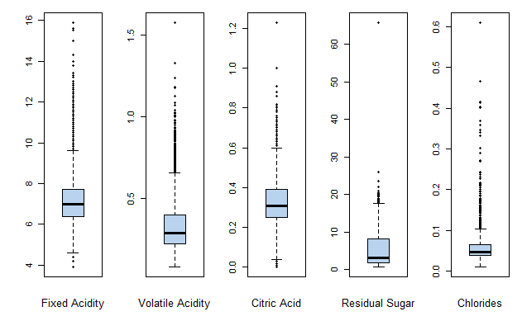
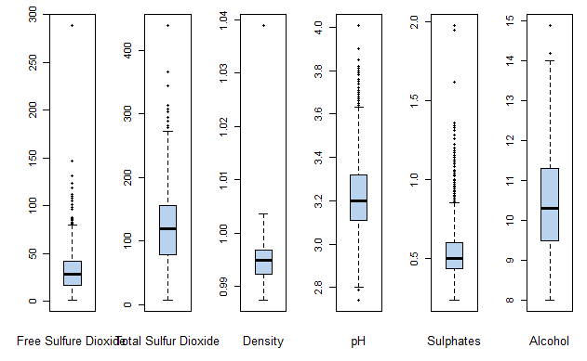
Distribution of Each Continuous Predictor

Slide 5
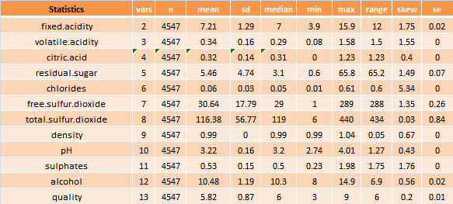
Basic Statistics of Each Continuous Variable

Slide 6
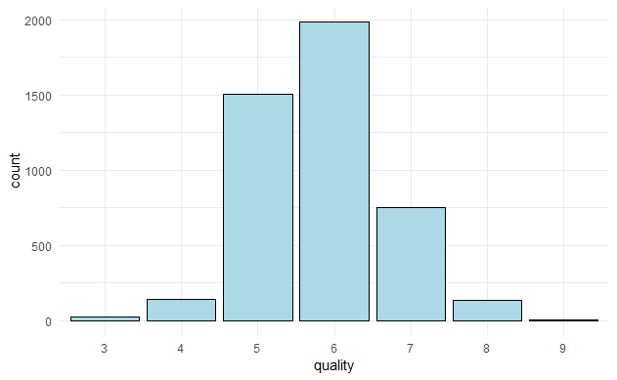
Frequency of each Quality Rating

Slide 7
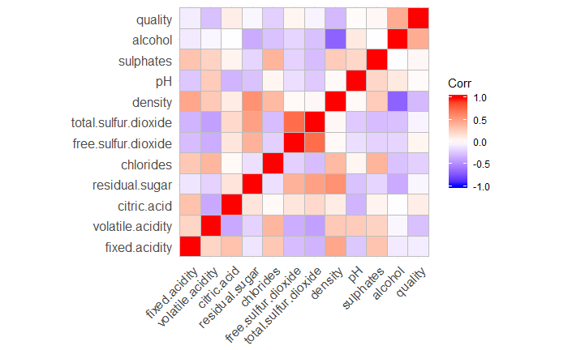
Correlation Matrix

Slide 8
Our Hypothesis:
-Alcohol, density, and volatile acidity will be three of the most significant predictors in our final model.

Slide 9
CLASSIFICATION VS. REGRESSION
Our outcome variable (Quality) is a rating scale from 3-9.
Can be considered Classification or Regression, so both types of analysis will be done.
For Regression Analysis we will code quality as numeric and create dummy variables for the wine type (red/white).
For Classification Analysis we will code quality as a factor.

Slide 10
Linear Regression Model (Regression)
Linear Regression was considered first because it is a well known model that is very fast and is interpretable.
reglog.fit <- lm(quality ~ ., data = regtrain) reglog.pred <- round(predict(reglog.fit, regtest), 0) 1 - mean(reglog.pred == regtest$quality)
The error rate for the Linear Regression model is: 0.4739545

Slide 11
Logistic Regression Model (Classification)
Similarly, Logistic Regression was considered first for classification because it is a well known model that is very fast and is interpretable for classification.
We used the function polr which fits a logistic regression model to an ordered factor response which in our case is the quality.
The logistic regression and linear regression model performed about the same with a ~0.47 test error rate.
classlog.fit <- polr(quality ~ ., data = classtrain) classlog.pred <- predict(classlog.fit, classtest, type = "class") 1 - mean(classlog.pred == classtest$quality)
The error rate for the Logistic Regression model is: 0.4680851

Slide 12
Support Vector Machines
SVM was chosen because it has a regularisation parameter and it gives the option to change the kernel. It can also be more efficient because it uses a subset of training points.
The test error rate when doing Regression is: 0.4460748
The test error rate when doing Classification is: 0.4651504
When treating quality as a regression problem, SVM performed better with a test error rate of ~0.44.
reg.svm_fit <- svm(quality ~ . - citric.acid, data = regtrain, kernel = "radial", cost = .10, scale = T) reg.svm_pred <- round(predict(reg.svm_fit, regtest),0) table(reg.svm_pred, regtest$quality) 1 - mean(reg.svm_pred==regtest$quality)

Slide 13
K-Nearest Neighbors
KNN was considered because it is a non-parametric technique that makes no assumptions. It also lets the user tune the number of neighbors (k).
KNN performs similarly for both Regression and Classification with a test error rate of ~0.42
regknn.mod <- knn.reg(regtrain$quality, train = regtrain, test = regtest, k=1) table(round(regknn.mod$pred, 0), regtest$quality) 1 - mean(round(regknn.mod$pred, 0) == regtest$quality)
The test error rate for the KNN Regression is: 0.4196625 The test error rate for the KNN Classifier is: 0.4240646

Slide 14
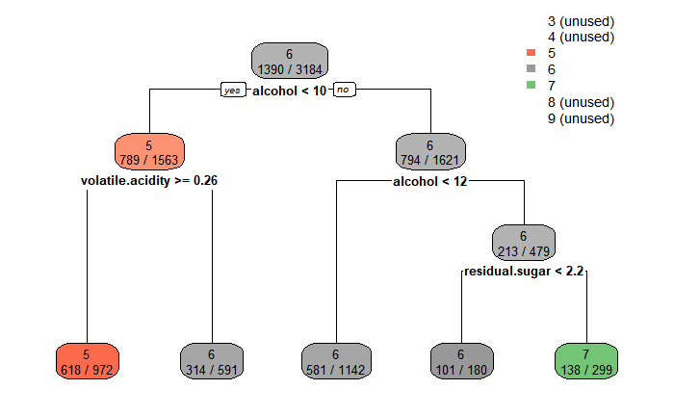
Pruned Tree Model
Tree Models are very interpretable but the High Variance leads to a relatively high test error rate for both Classification and Regression with around ~0.46

Slide 15
Random Forest
Random forest will be used because it builds multiple decision trees and merges them together to get a more accurate and stable prediction. It reduces Variance without increasing Bias by too much
t.ctrl <- trainControl(method = "optimism_boot", number = 5)
rf.grid <- expand.grid(mtry = 2)
regrf.train <- train(quality ~ .- citric.acid, data = regtrain, method = "rf",
trControl = t.ctrl, tuneGrid = rf.grid,
preProcess = c("center", "scale"), do.trace = F, n.tree =500)
regrf.pred <- round(predict(regrf.train, regtest),0)
1 - mean(regrf.pred == regtest$quality)
The test error rate for Regression is: 0.355099
The test error rate for Classification is: 0.3639032
Both performed similarly but treating Quality as numeric with the Random Forest Model had the least test error rate with ~0.35

Slide 16
The Final Model
The random forest model that treated quality as a numeric outcome was ultimately our best model.
When we treated quality as a factor, we obtained a test error rate of about .363. However, when we treated quality as a numeric variable, we achieved a test error rate of approximately .355, which implies the model is about 65% accurate.
We believe that this model outperformed the others due to the fact that random forest models are typically more flexible and they lower variance fairly quickly.

Slide 17
What We Learned About the Dataset and Variables
Initially, we suspected that the predictors “alcohol,” “volatile acidity,” and “density” would be significant independent variables in our final model. Our pruned tree showed that “alcohol” and “volatile acidity” did indeed prove to be important predictors in wine quality with “residual sugar” turning out to be more significant than “density”.
Based on the slight increase in AIC when we added “citric acid” into our stepwise regression, it indicated that our model would perform better if we removed the predictor. This information led us to exclude “citric acid” in the rest of our analyses.
Also, in a majority of the models, we learned that treating quality as either numeric or a factor did not change the test error rate by much.

Slide 18
How Can We Improve Our Analysis?
We believe that our analyses could be improved with additional data, more specifically data on wines with “lower” or “higher” ratings to improve upon the unbalanced data in the present data set.
Additionally, if we could have binned the ratings together into “below average,” “average,” and “above average,” we could have achieved models with better accuracy.
Finally, two other factors that could have improved our analyses are more predictors and creating two separate models: one that predicts white wine quality and one that predicts red wine quality.

